Slide 1
Smart Bill Splitting App
Split bill in your group easily
Created by Surya Das

Slide 2

9$
1$
Hangout With Friends?
7$
5$
Paid non uniformly?

Slide 3

?
How to calculate now

Slide 4
Simple!
Use Split it!
Add Members / Remove Members – Split Bills

Slide 5
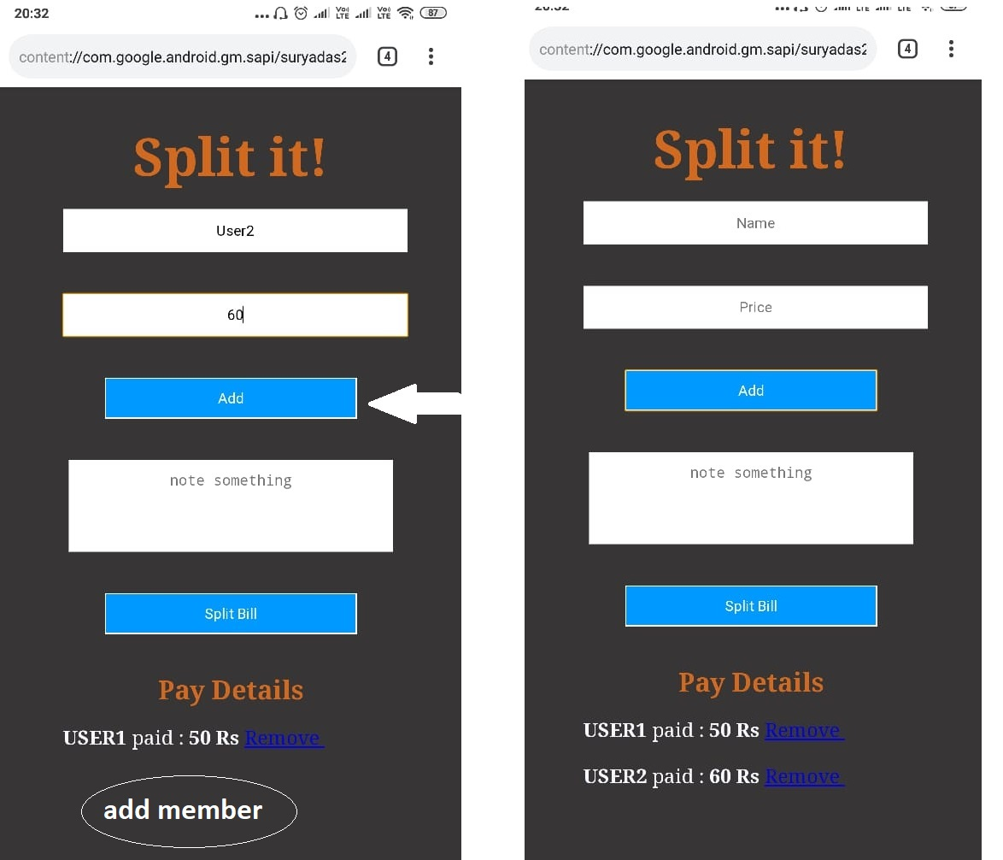
Add Members

Slide 6
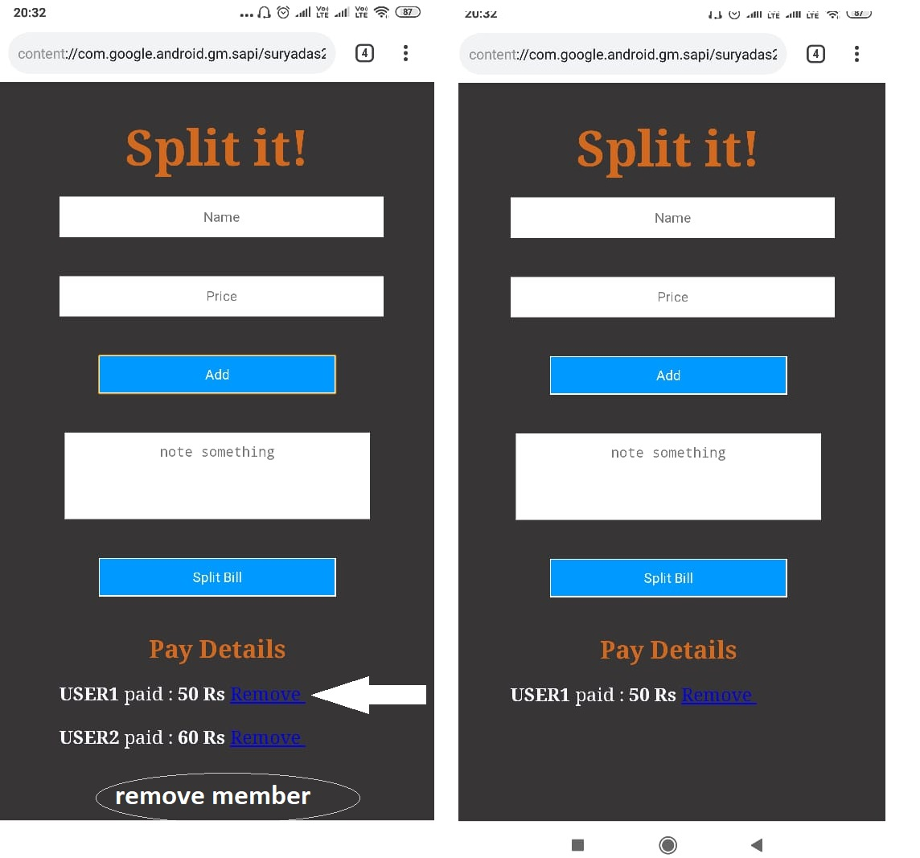
Remove Members

Slide 7
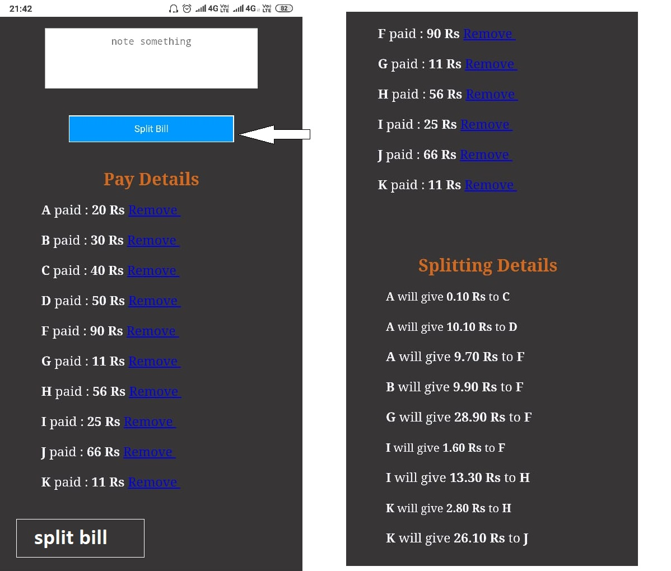
Split Bills

Slide 8
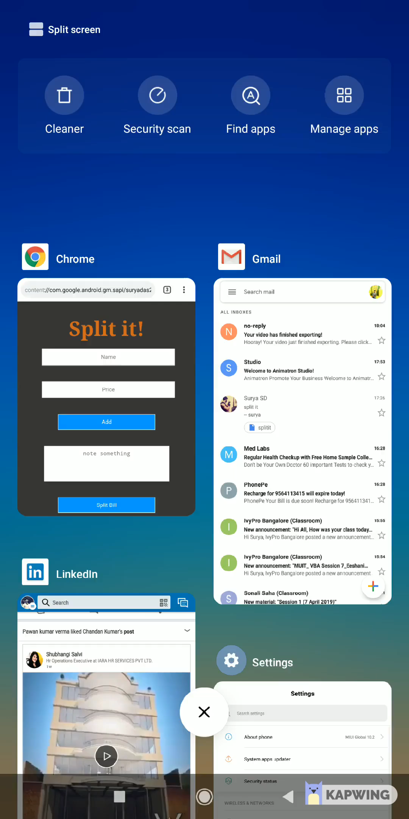
A small clip how it works

Slide 9
Thank You!

